Slide 1
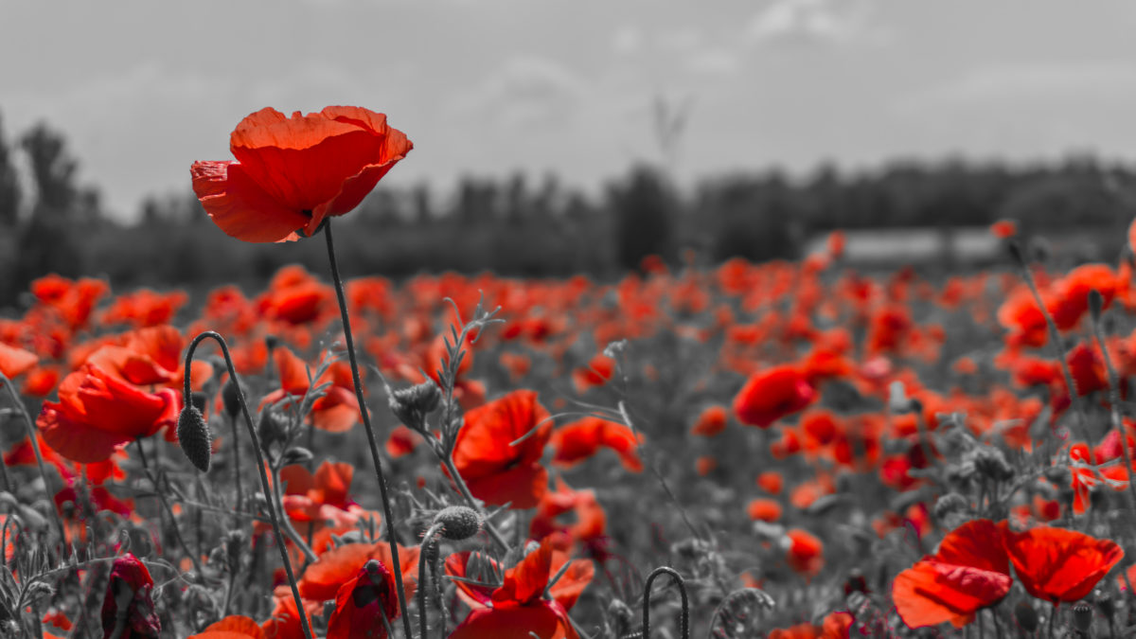
We Will Remember
Devon Middle School
November 2025
Notes:
Upon entry Solium march, song of peace, All is well. Entrance of Special guests “Star Splitter Fafnir”

Slide 2
Land Acknowledgement
Kwolahsihkulpon
Yut Askomi
Ntopeltomeq
Nkihtahkomumon
Wolastoqewiyik Ihkatomone
Ehtahsikiskahk
Nit Leyic!
We welcome you to our unseeded homeland of our people of the beautiful and bountiful river Wolastoq.

Slide 3

“O Canada”
Notes:
Lead by DSM singers DMS Sympathy Orchestra

Slide 4
DMS Choir –I Wish You Peace
Notes:
DMS Singers

Slide 5
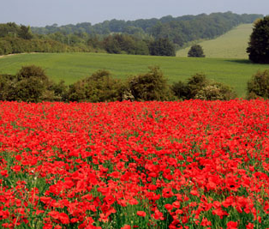
We Will Remember
In Flanders Fields, the poppies blow
Between the crosses, row on row,
That mark our place; and in the sky
The larks, still bravely singing, fly
Scarce heard amid the guns below.
We are the dead. Short days ago
We lived, felt dawn, saw sunset glow,
Loved and were loved, and now we lie,
In Flanders fields.
Take up our quarrel with the foe:
To you from failing hands we throw
The torch; be yours to hold it high.
If ye break faith with us who die
We shall not sleep, though poppies grow
In Flanders fields.
Flanders Fields
Written by John McCrae
Read by Lily C

Slide 6
We Will Remember
Pemskutek Flandersuwihkuk-Waht pemskutek Flandersuwihkuk cel pehsuwahsuweskil etololamsok yut ehetuwiw cipiyatkuk eyihtit.
Sipsisok tolintuhtuwok kenuk wahkahtaqsultuwok pemituwiyahtihtit ipocol piyemi-cipokihtaqotul peskuwatiyil emehkew
Nilun mehcinhotipon kenuk yut-te piliw npomawsultiponuhpon, nomihtunenuhpon weckuwapok naka-tehna kisuhs elomi-komuhset
eci-woli-pitiyahtuwessitpon. 'Tanaqsuwok kisi-kselomeq naka-tehna koselomokeponuhpon, kenuk toke ntolossinultipon yut,
pemskutek Flanderswihkuk. Wihqehtuwine eli-matonahkamok ketuwihponolinomok. Kiluwaw toke kpomiptuniya. Skat wihqehtuwehq,
kat-op-nkisi-sankewqahsultihpon apeq-oc mec pomikonul pehsuwahsuweskil pemskutek Flanderswihkuk. John McCrae nit itok.
Pemskutek Flandersuwihkuk
Read by Stone

Slide 7
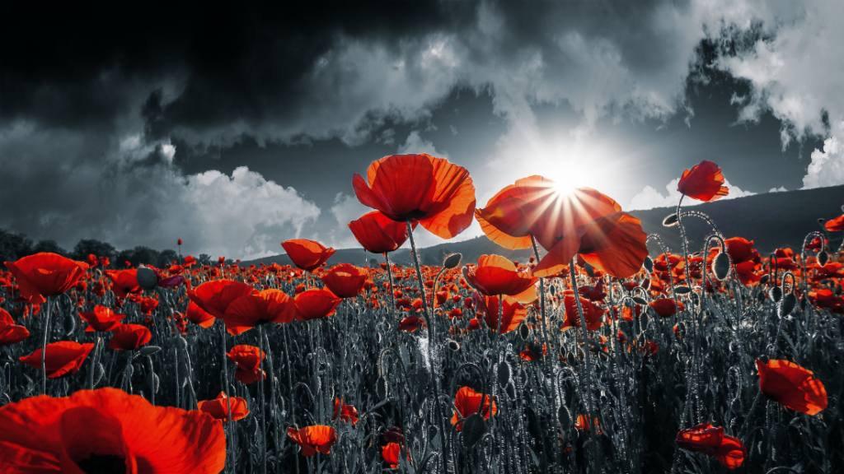
We Will Remember
Why Wear a Poppy?
Written by Don Crawford
Read By Lily G

Slide 8
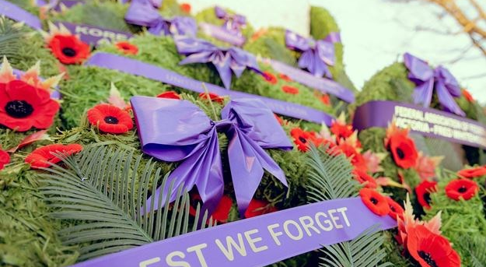
We Will Remember
Laying of Wreaths
Notes:
Band: Flowing Stream and Orchestra “Inner Light”

Slide 9
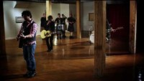
Highway of Hero's

Slide 10
We Will Remember
Guest Speaker
Bob Griffin

Slide 11
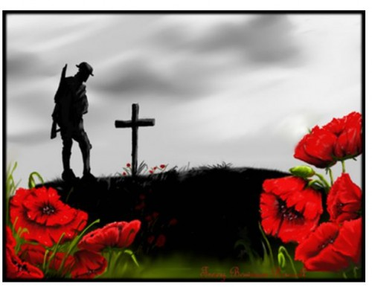
We Will Remember
Micheal H
Act of Remembrance
They shall grow not old,
as we that are left grow old:
Age shall not weary them,
nor the years condemn.
At the going down of the sun
and in the morning
We will remember them.
RESPONSE: We will remember them.

Slide 12
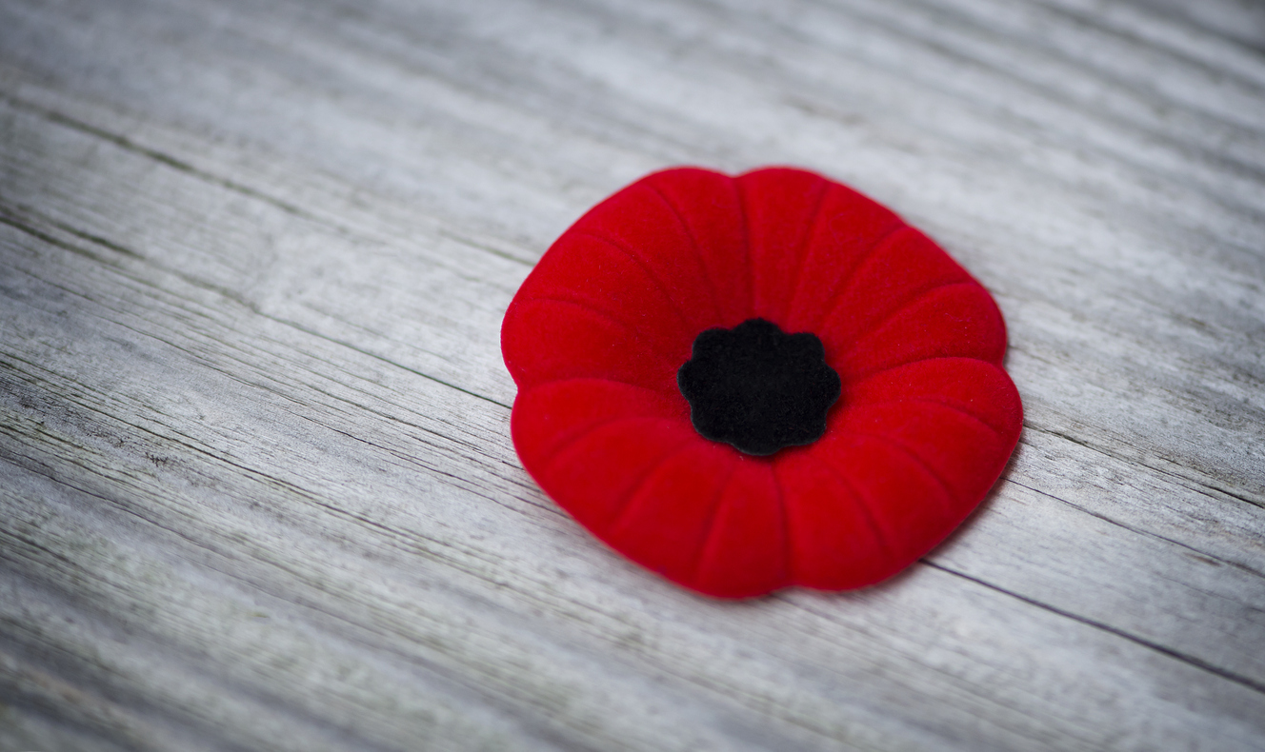
We Will Remember
Last Post
2 minutes of Silence
Rouse
Notes:
canada.ca/content/dam/themes/defence/caf/militaryhistory/dhh/music/last-post-dernier-appel.wav
canada.ca/content/dam/themes/defence/caf/militaryhistory/dhh/music/rouse-reveille.wav

Slide 13
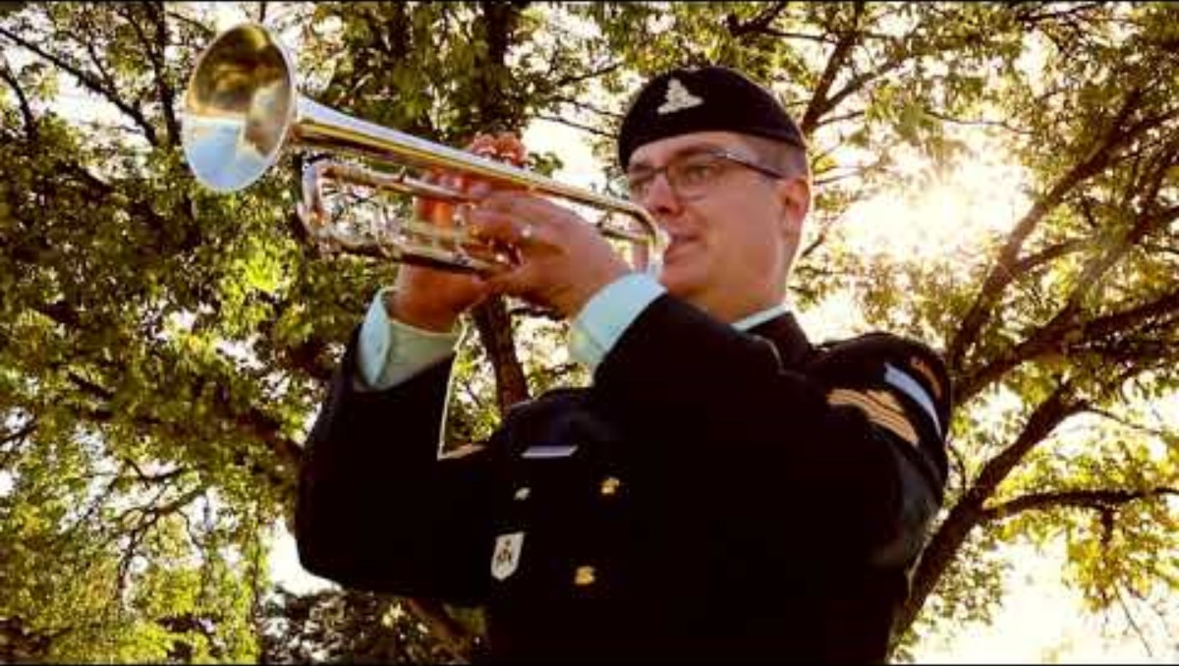

Slide 14
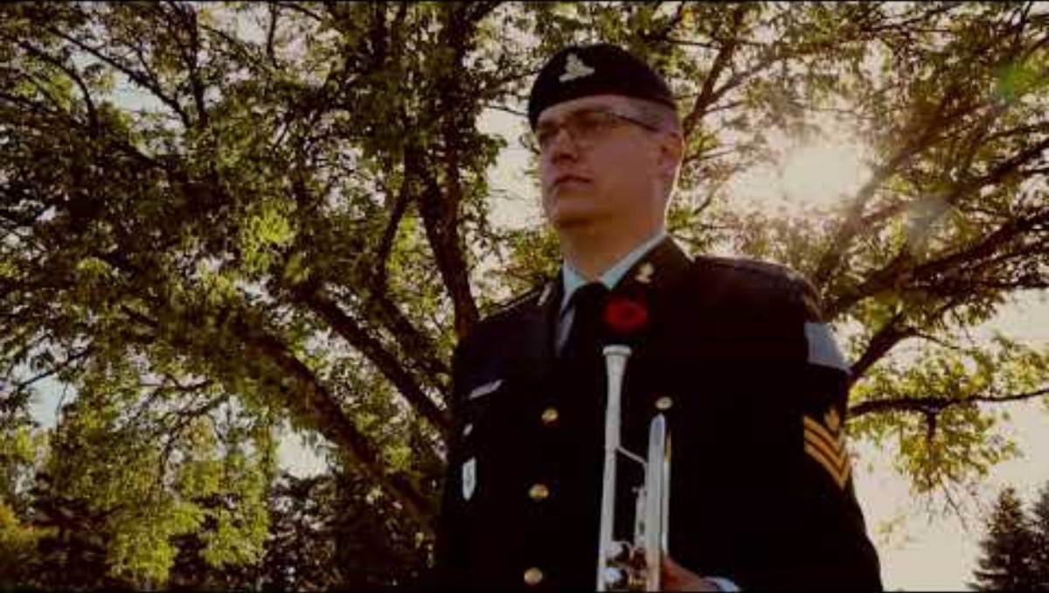

Slide 15
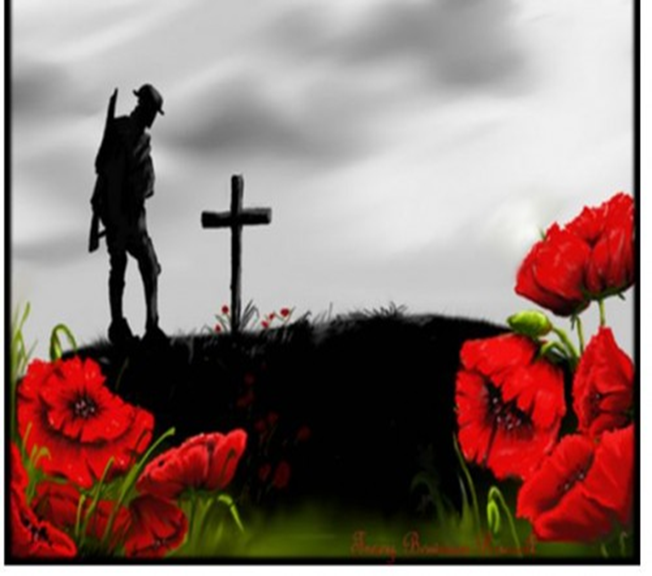
We Will Remember
Della R
Commitment to Remember
They shall grow not old,
as we that are left grow old:
Age shall not weary them,
nor the years condemn.
At the going down of the sun
and in the morning
We will remember them.
RESPONSE: We will remember them.

Slide 16
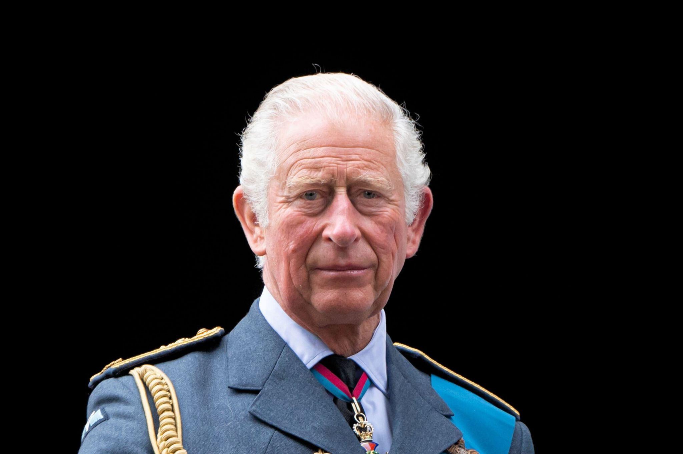
God Save the King
God save our gracious King
Long live our noble King,
God save The King:
Send him victorious,
Happy and glorious,
Long to reign over us:
God save The King.
O Lord, our God, arise,
Scatter thine enemies,
And make them fall:
Confound their politics,
Frustrate their knavish tricks,
On thee our hopes we fix:
God save us all.
Thy choicest gifts in store,
On him be pleased to pour;
Long may he reign:
May he defend our laws,
And ever give us cause
To sing with heart and voice
God save The King.
Notes:
DMS SRTING and Singers

Slide 17

We Will Remember
Closing Remarks

Slide 18
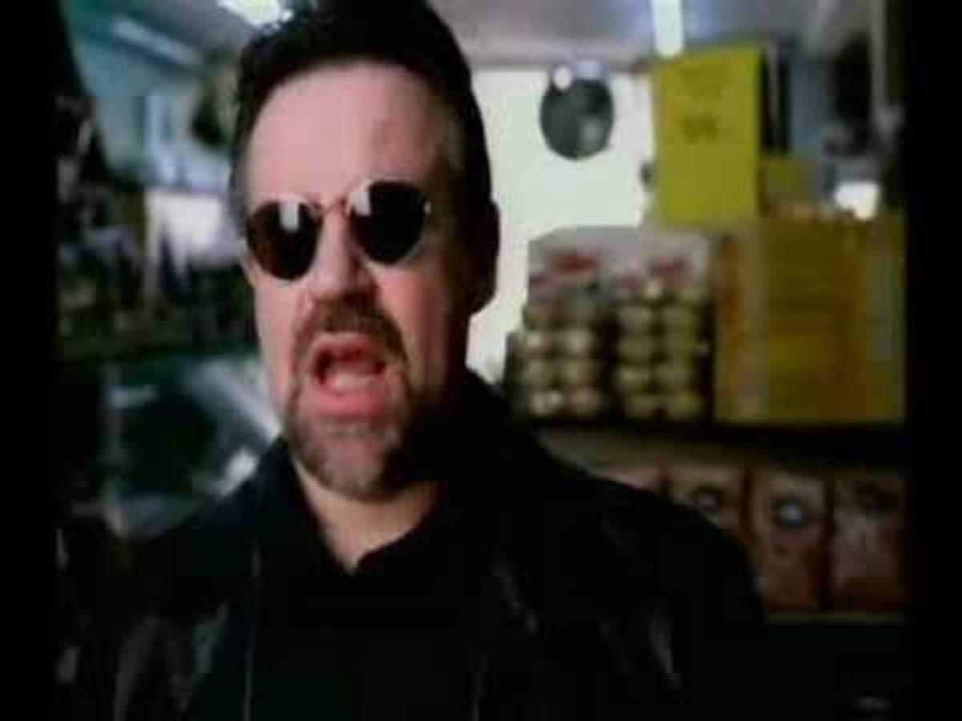
Notes:
DMS Band

